Slide 1
Threads

Slide 2
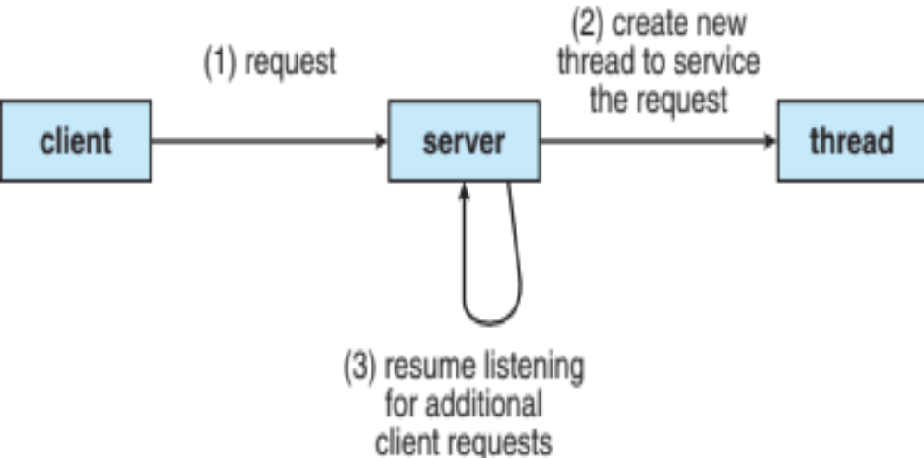
Multithreaded Server Architecture

Slide 3
Multicore Programming (Cont.)
Types of parallelism
  Data parallelism – distributes subsets of the same data across multiple cores, same operation on each
  Task parallelism – distributing threads across cores, each thread performing unique operation
As # of threads grows, so does architectural support for threading
  CPUs have cores as well as hardware threads
  Consider Oracle SPARC T4 with 8 cores, and 8 hardware threads per core

Slide 4
Thread
A thread is a single sequential flow of execution of tasks of a process
    so it is also known as thread of execution or thread of control.
Threads
Called a light weight process
  A thread is a basic unit of CPU utilization
  Multi-threaded processes share data for greater efficiency

Slide 5

Single and Multithreaded Processes

Slide 6
Four Primary Benefits of Threading
Responsiveness
  Interactive applications can respond to user while other threads are blocked on I/O or performing lengthy computations
Resource Sharing
  Threads share memory, code, and data, which enables several threads of activity within the same address space
Economy/Efficiency
  Resource allocation is costly. Sharing reduces overhead and reduces the cost of context switching during CPU scheduling
Utilization of Multiprocessor Architectures
  Can leverage multi-CPU architectures for genuine parallelism

Slide 7
User Threads and Kernel Threads
User threads - management done by user-level threads library
kernel knows nothing about threads
User library handles
    Thread creation
    Thread deletion
    Thread scheduling
  Benefits:
  Faster creation and scheduling
  Drawbacks:
  One thread blocking during I/O blocks all threads in process (even ready-to-run threads)
Three primary thread libraries:
    POSIX Pthreads
    Windows threads
    Java threads

Slide 8
Kernel Threads
Kernel threads - Supported by the Kernel
Kernel handles
  thread creation, deletion, scheduling
Benefits:
  Kernel can schedule another thread if current one does blocking I/O
  Kernel can schedule multiple threads on different CPUs on SMP multiprocessor
Drawbacks:
  Slower to schedule, create, delete than user-level
Examples – virtually all general purpose operating systems, including:
    Windows
    Solaris
    Linux
    Mac OS X

Slide 9
Multithreading Models
Many-to-One
One-to-One
Many-to-Many

Slide 10

Many-to-One
Many user-level threads mapped to single kernel thread
One thread blocking causes all to block
Multiple threads may not run in parallel on muticore system because only one may be in kernel at a time
Few systems currently use this model
Examples:
  Solaris Green Threads
  GNU Portable Threads

Slide 11
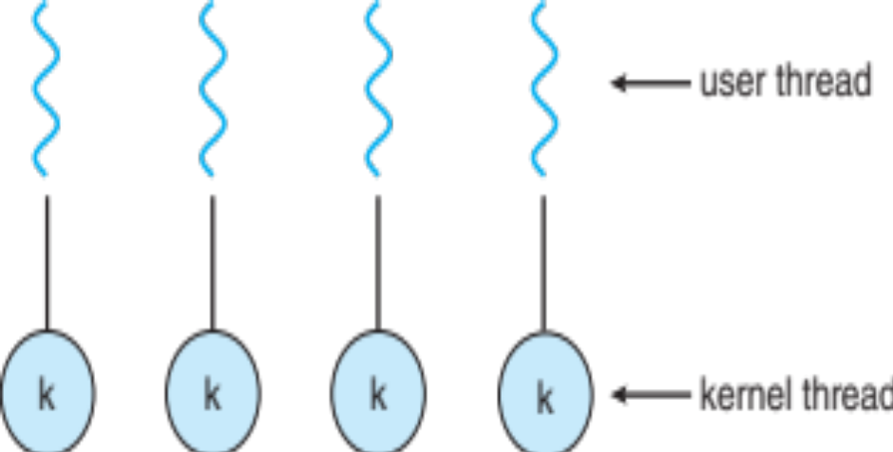
One-to-One
Each user-level thread maps to kernel thread
Creating a user-level thread creates a kernel thread
More concurrency than many-to-one
Number of threads per process sometimes restricted due to overhead
Examples
  Windows
  Linux
  Solaris 9 and later

Slide 12
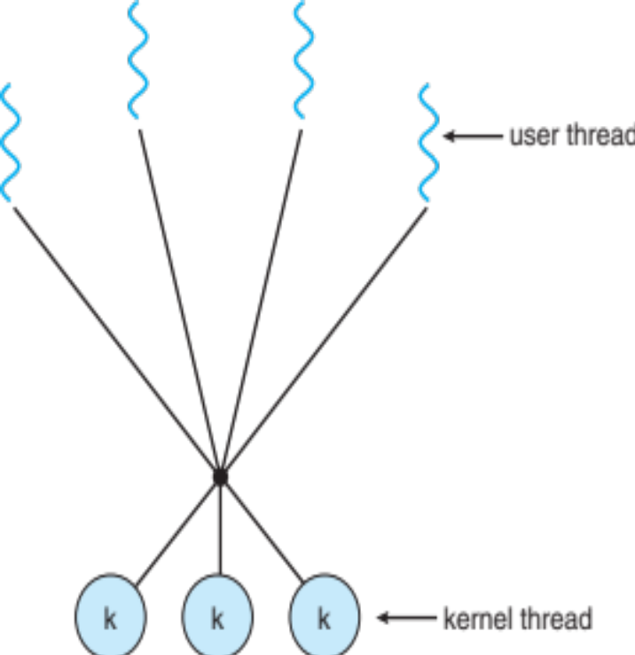
Many-to-Many Model
Allows many user level threads to be mapped to many kernel threads
Allows the operating system to create a sufficient number of kernel threads
  Solaris prior to version 9
  Windows with the ThreadFiber package

Slide 13

Two-level Model
Similar to M:M, except that it allows a user thread to be bound to kernel thread
Examples
  IRIX
  HP-UX
  Tru64 UNIX
  Solaris 8 and earlier

Slide 14
Thread Libraries
Thread library provides programmer with API for creating and managing threads
Two primary ways of implementing
    Library entirely in user space
    Kernel-level library supported by the OS

Slide 15
Pthreads
May be provided either as user-level or kernel-level
A POSIX standard (IEEE 1003.1c) API for thread creation and synchronization
Specification, not implementation
API specifies behavior of the thread library, implementation is up to development of the library
Common in UNIX operating systems (Solaris, Linux, Mac OS X)

Slide 16
Threading Issues
Semantics of fork() and exec() system calls
Signal handling
    Synchronous and asynchronous
Thread cancellation of target thread
    Asynchronous or deferred
Thread-local storage
Scheduler Activations

Slide 17
a. Semantics of fork() and exec()
Does fork()duplicate only the calling thread or all threads?
  Some UNIX have two versions of fork
exec() usually works as normal – replace the running process including all threads
Which version should one use?
  If exec() is called immediately after fork()
    Only the calling thread needs to be duplicated
    Why? Because exec() replaces the whole process anyway
  If exec() is not called after fork()
    Then typically duplicate all threads

Slide 18
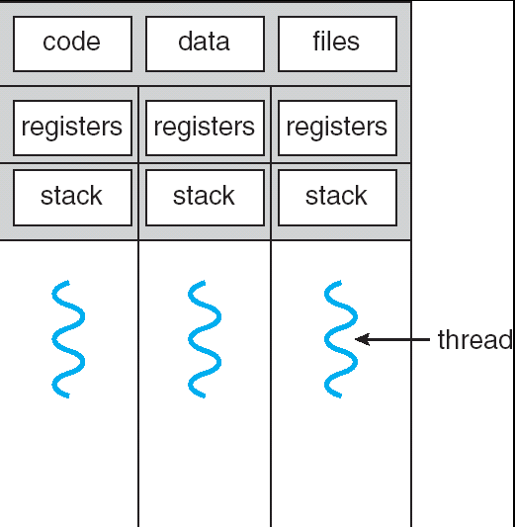
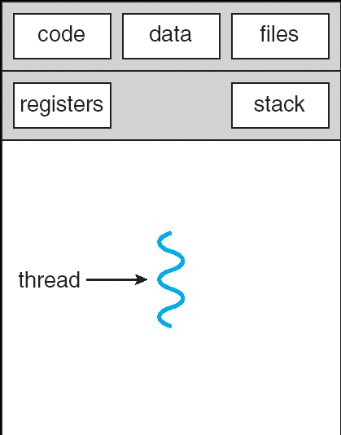
Some UNIX systems have two versions of fork()
exec() usually replaces all threads with new program
fork1()
fork2()

Slide 19
b. Signal Handling
Signals are used in UNIX systems to notify a process that a particular event has occurred.
A signal handler is used to process signals
  Signal is generated by particular event
  Signal is delivered to a process
  Signal is handled by one of two signal handlers:
  signal may be handled by one of two possible handlers
    default
    user-defined
Every signal has default handler that kernel runs when handling signal
  User-defined signal handler can override default
  For single-threaded, signal delivered to process

Slide 20
Signal Handling (Cont.)
Where should a signal be delivered for multi-threaded?
  Deliver the signal to the thread to which the signal applies
  Deliver the signal to every thread in the process
  Deliver the signal to certain threads in the process
  Assign a specific thread to receive all signals for the process

Slide 21

c. Thread Cancellation
Thread Cancellation-Terminating a thread before it has finished
  Thread to be canceled is - target thread
Two general approaches(target thread):
  Asynchronous cancellation- terminates the target thread immediately
  Deferred cancellation allows the target thread to periodically check if it should be cancelled
Pthread code to create and cancel a thread:

Slide 22

Thread Cancellation (Cont.)
Invoking thread cancellation requests cancellation, but actual cancellation depends on thread state
If thread has cancellation disabled, cancellation remains pending until thread enables it
Default type is deferred
  Cancellation only occurs when thread reaches cancellation point
    I.e. pthread_testcancel()
    Then cleanup handler is invoked
On Linux systems, thread cancellation is handled through signals

Slide 23
d. Thread-Local Storage
Thread-local storage (TLS) allows each thread to have its own copy of data
Useful when you do not have control over the thread creation process (i.e., when using a thread pool)
Different from local variables
  Local variables visible only during single function invocation
  TLS visible across function invocations
Similar to static data
  TLS is unique to each thread

Slide 24

e. Scheduler Activations
Both M:M and Two-level models require communication to maintain the appropriate number of kernel threads allocated to the application
Typically use an intermediate data structure between user and kernel threads – lightweight process (LWP)
  Appears to be a virtual processor on which process can schedule user thread to run
  Each LWP attached to kernel thread
  How many LWPs to create?
Scheduler activations provide upcalls - a communication mechanism from the kernel to the upcall handler in the thread library
This communication allows an application to maintain the correct number kernel threads

Slide 25
Operating System Examples
Windows Threads
Linux Threads

Slide 26
Windows Threads
Windows implements the Windows API – primary API for Win 98, Win NT, Win 2000, Win XP, and Win 7
Implements the one-to-one mapping, kernel-level
Each thread contains
  thread id
  Register set representing state of processor
  Separate user and kernel stacks for when thread runs in user mode or kernel mode
  Private data storage area used by run-time libraries and dynamic link libraries (DLLs)
register set, stacks, and private storage area are known as the context of the thread

Slide 27
Windows Threads (Cont.)
The primary data structures of a thread include:
  ETHREAD (executive thread block) – includes pointer to process to which thread belongs and to KTHREAD, in kernel space
  KTHREAD (kernel thread block) – scheduling and synchronization info, kernel-mode stack, pointer to TEB, in kernel space
  TEB (thread environment block) – thread id, user-mode stack, thread-local storage, in user space

Slide 28

Windows Threads Data Structures

Slide 29
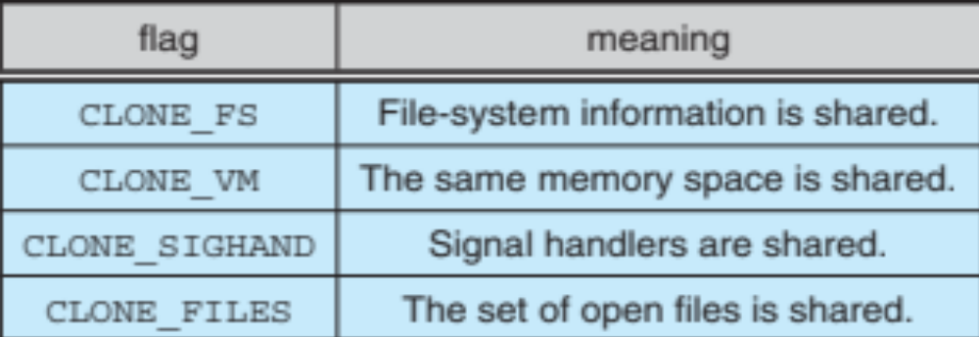
Linux Threads
Linux refers to them as tasks rather than threads
Thread creation is done through clone() system call
clone() allows a child task to share the address space of the parent task (process)
  Flags control behavior
struct task_struct points to process data structures (shared or unique)

